Slide 1
Chapter 8
Data Modeling
Part 1

Slide 2
Data Modeling
Entity
  a class of persons, places, objects, events, or concepts about which data is captured and stored
  an instance is a single occurrence of an entity

Slide 3
Entity
Entity
Student ID | Last Name | First Name
2144 | Arnold | Betty
3122 | Taylor | John
3843 | Simmons | Lisa
9844 | Macy | Bill
2837 | Leath | Heather
2293 | Wrench | Tim
Instances

Slide 4
Attribute (column)
  a descriptive property or characteristic of an entity, also know as field, element, and property
Relationship
  a natural association between one or more entities

Slide 5
Attributes
Compound Attribute
Data Type
Domain
Default Value

Slide 6
Data Type
Representative Logical Data Types for Attributes
Data Type | Logical Business Meaning
NUMBER | Any number, real or integer.
TEXT | A string of characters, inclusive of numbers. When numbers are included in a TEXT attribute, it means that we do not expect to perform arithmetic or comparisons with those numbers.
MEMO | Same as TEXT but of an indeterminate size. Some business systems require the ability to attach potentially lengthy notes to a give database record.
DATE | Any date in any format.
TIME | Any time in any format.
YES/NO | An attribute that can assume only one of these two values.
SUBSET | A finite set of values. In most cases, a coding scheme would be established (e.g., FR=Freshman, SO=Sophomore, JR=Junior, SR=Senior).
IMAGE | Any picture or image.

Slide 7
Domain
Representative Logical Domains for Logical Data Types
Data Type | Domain | Examples
NUMBER | For integers, specify the range. For real numbers, specify the range and precision. | {10-99} {1.000-799.999}
TEXT | Maximum size of attribute. Actual values usually infinite; however, users may specify certain narrative restrictions. | Text(30)
DATE | Variation on the MMDDYYYY format. | DDMMMYYYY MMYY
TIME | For AM/PM times: HHMMT For military (24-hour times): HHMM | HHMMT HHMM
YES/NO | {YES, NO} | {YES, NO} {ON, OFF}
SUBSET | {value#1, value#2,…value#n} {table of codes and meanings} | {M=Male F=Female}

Slide 8
Default Value
Permissible Default Values for Attributes
Default Value | Interpretation | Examples
A legal value from the domain | For an instance of the attribute, if the user does not specify a value, then use this value. | 0 1.00
NONE or NULL | For an instance of the attribute, if the user does not specify a value, then leave it blank. | NONE NULL
Required or NOT NULL | For an instance of the attribute, require that the user enter a legal value from the domain. (This is used when no value in the domain is common enough to be a default but some value must be entered.) | REQUIRED NOT NULL

Slide 9
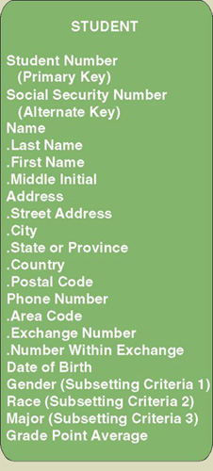
Identification
Key
Concatenated Key
Candidate Key
Primary Key
Alternate Key
Subsetting Criteria

Slide 10
Relationships
Cardinality
Degree
Recursive Relationship
Associative Entity
Foreign Keys
Identifying Relationship
Non-Identifying Relationship
Non-Specific Relationship

Slide 11
Relationship
A relationship is a natural business association that exists between one or more entities
All relationships are implicitly bi-directional, meaning they can be interpreted in both directions

Slide 12
Cardinality
Cardinality defines the minimum and maximum number of occurrences of one entity for a single occurrence of the related entity
Because all relationships are bi-directional, cardinality must be defined in both directions for every relationship

Slide 13
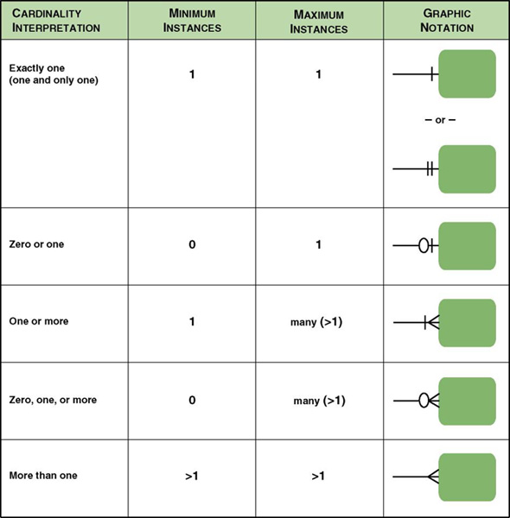
Cardinality Notations
Notes:
Teaching Notes
Although this figure shows five different options, help students see that there are really only two options for minimum cardinality (0 or 1) and two options for maximum cardinality (1 or many).

Slide 14
Degree
The degree of a relationship is the number of entities that participate in the relationship
A relationship between different instances of the same entity is known as a recursive relationship (degree = 1)
A relationship between 2 entities is known as a binary relationship (degree = 2)
A relationship between 3 entities is known as a ternary relationship (degree = 3)

Slide 15
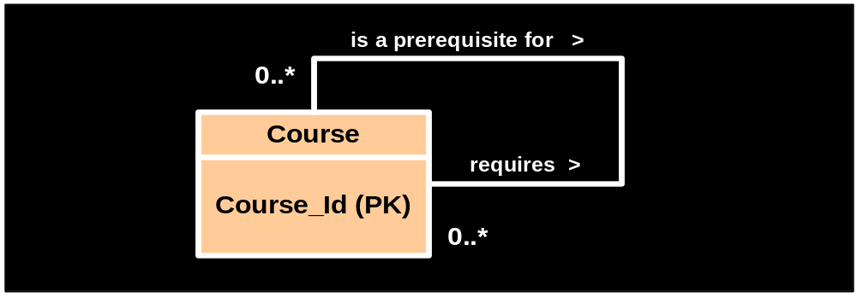
Recursive Relationship

Slide 16
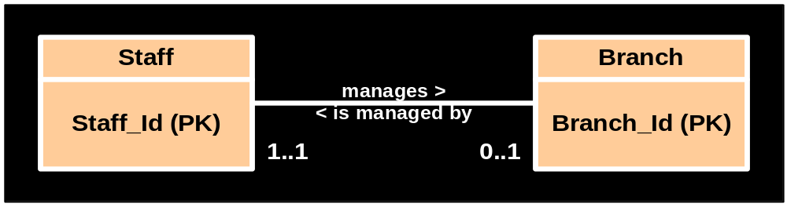
Binary Relationship

Slide 17
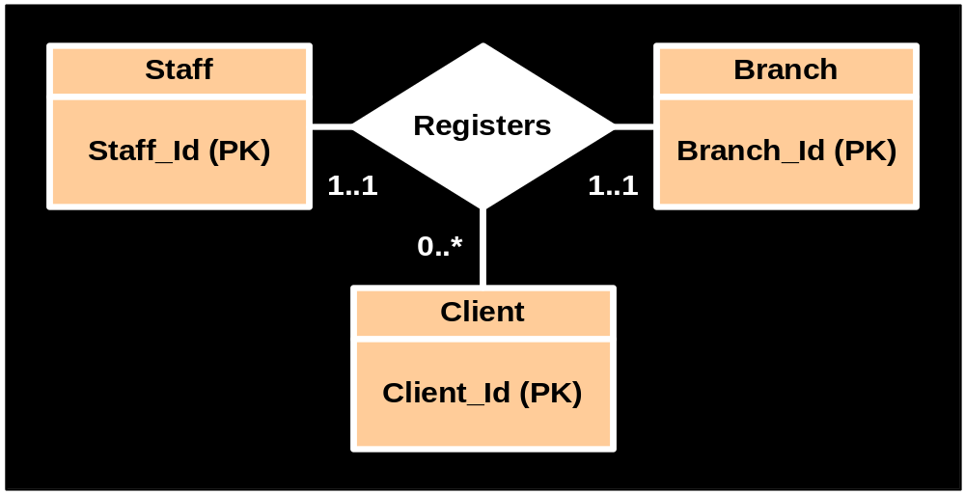
Ternary Relationship

Slide 18
Foreign Key
A foreign key is a primary key of one entity that is duplicated in another entity to identify instances of a relationship
A foreign key must always match the primary key of the source entity. If it does not it will compromise referential integrity
It may be null if the referenced entity occurrence is optional

Slide 19
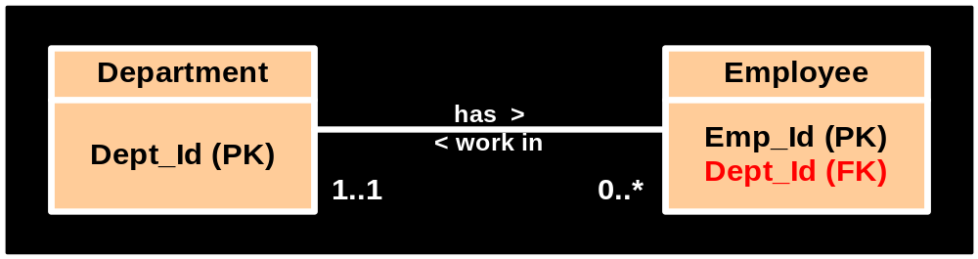
Foreign Key

Slide 20
Non-Identifying Relationship
A non-identifying relationship is one which the participating entities have their own independent primary keys that are not shared
Entities in this type are referred to as strong entities because they do not depend on any other entity for identification

Slide 21
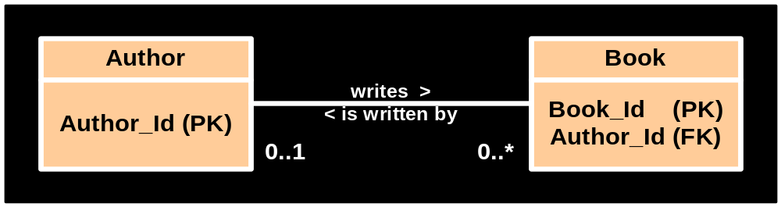
Non-Identifying Relationship

Slide 22
Identifying Relationship
Identifying relationships are those in which the parent entity contributes its primary key to become part of the primary key of the child entity
The child entity in this type of relationship is referred to as a weak entity because its identification is dependent on the existence of the parent

Slide 23
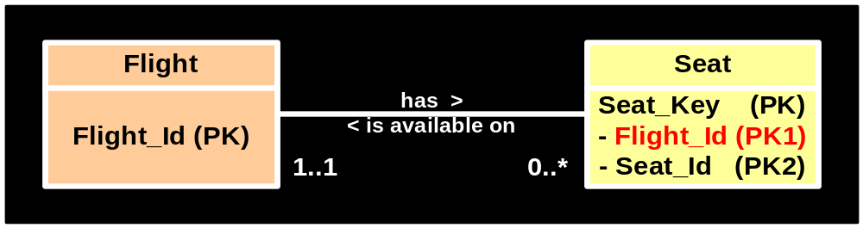
Identifying Relationship

Slide 24
Non-Specific Relationship
A non-specific (or many-to-many) relationship is one in which many instances of one entity are associated with many instances of another entity
Such relationships cannot be implemented . They are suitable for preliminary data models only and should be resolved as soon as possible

Slide 25
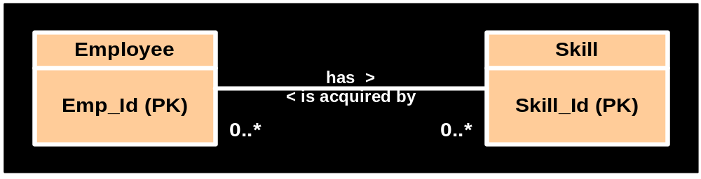
Non-specific Relationship (1)

Slide 26
Associative Entity
An entity that is created to resolve a non-specific relationship
Inherits its primary key from two or more parent entities and is inherently a weak entity
Each part of the concatenated key points to one and only one instance of each of the connected entities

Slide 27
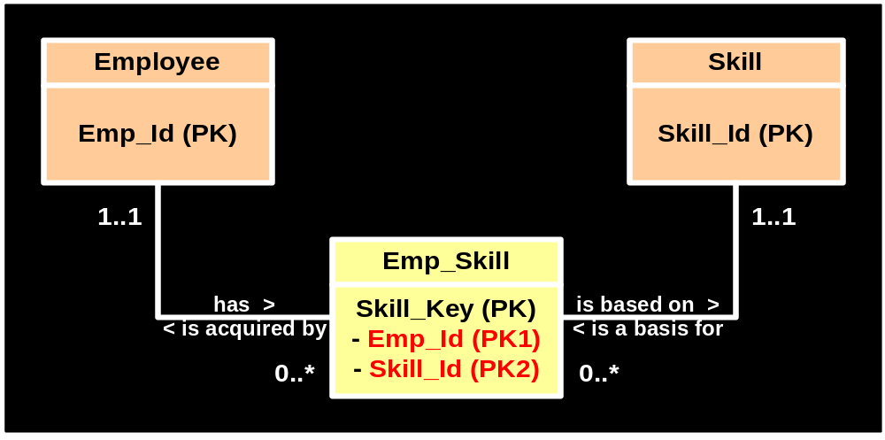
Associative Entity

Slide 28
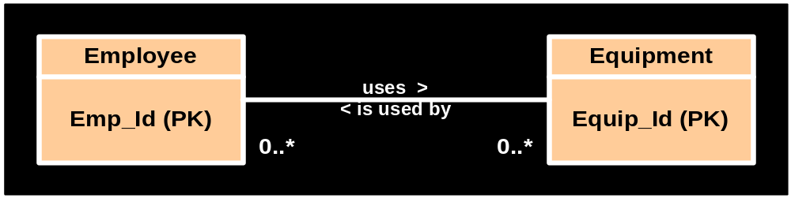
Non-specific Relationship (2)

Slide 29
Dependent Entity
An entity that is created to resolve a non-specific relationship
Has its own primary key as well as the foreign keys of the connected entities
Used for recording multiple combinations of instances of the connected entities

Slide 30
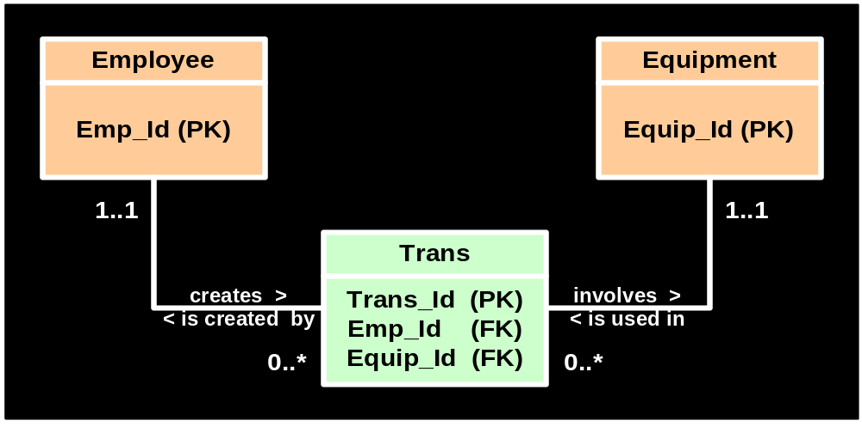
Dependent Entity

Slide 31
Generalization
A concept wherein the attributes that are common to several types of an entity are grouped into their own entity called a supertype.
An entity which inherits the common attributes from a supertype entity is known as a subtype.

Slide 32
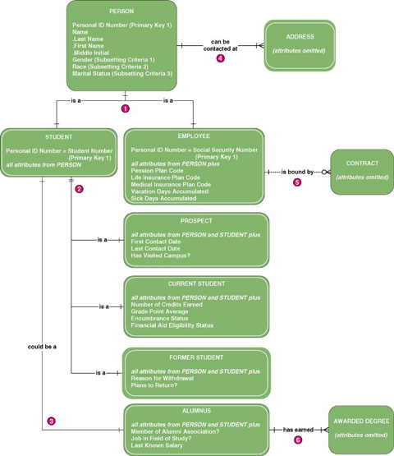
Generalization Hierarchy
Notes:
Teaching Notes
Generalization can be multiple levels deep.

Slide 33
End of Part 1

